Slide 1


Department of Computer Science and Engineering
EBILL DIGITAL RECIEPT GENERATOR
Mr.V.Karthik,
Department of CSE
Rajalakshmi Engineering College Chennai, India.
2116220701215 RAJAKUMARAN BHAVANISHRAJ 2116220701217 RAMYA P 2116220701236 SAFEEKUR RAHMAN A.Z.

Slide 2
Problem Statement
Environmental Impact – Paper receipts contribute to deforestation and waste.
Accessibility Issues – Hard to store, search, and retrieve physical receipts.
Security Risks – Paper receipts are easy to lose, damage, or forge.
Operational Costs – Continuous expense on paper, ink, and maintenance.
Lack of Insights – No support for detailed analytics or financial reporting.

Slide 3
Existing System
After a purchase, a paper receipt is printed and handed to the customer.
Customers often store receipts manually or capture them digitally for future reference.
Financial tracking and analysis require manual data entry from receipts.
Key challenges include: Loss or damage of physical receipts, Inefficient and time-consuming record-keeping, Environmental concerns due to paper consumption.

Slide 4
Objectives
Eliminate the use of paper receipts by providing secure digital alternatives.
Automate receipt generation and storage using a web-based MERN stack solution.
Improve accessibility by enabling users to view and manage receipts anytime.
Enhance security through centralized, tamper-proof digital records.
Enable financial insights with monthly and yearly reports and analytics.
Promote sustainability by reducing paper usage and operational costs.

Slide 5
Abstract
A MERN-based Digital Receipt Generator (DRG) system.
Replaces paper receipts with secure and eco-friendly digital receipts.
Enables automatic receipt generation and cloud storage.
Solves issues like loss, manual entry, and environmental impact.
Provides monthly/yearly reports and business data analytics.
Aims to enhance efficiency, security, accessibility, and sustainability.

Slide 6
Proposed System
User Authentication: Secure login using JWT and bcrypt for data protection.
Purchase Data Capture: Users enter transaction details via the interface.
Data Storage: Data is securely stored in MongoDB with encryption.
Receipt Generation: Digital receipts are created in JSON/PDF formats.
Receipt Management: Users can search, view, and download receipts anytime.
Report & Analytics: Generates monthly/yearly reports and financial visualizations.

Slide 7
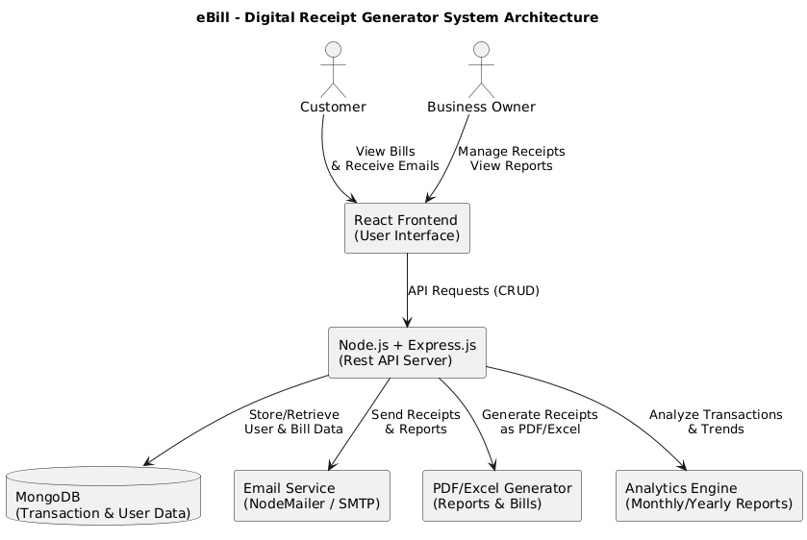
System Architecture

Slide 8
List of Framework
Frontend: HTML, CSS, and JavaScript.
Backend: Node.js with Express.js.
Database: MongoDB for data storage.
Frameworks: React.js (frontend), Express.js (backend).
Tools: VS Code, GitHub, and npm for development and version control.

Slide 9
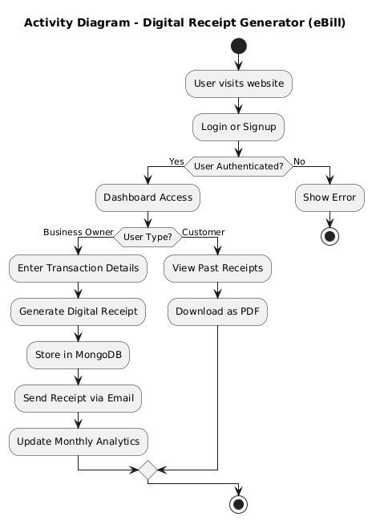
Functional Description for each modules with DFD and Activity Diagram
User Login/Registration: User securely logs in or registers to access the system.
Transaction Initiation: User enters purchase details, triggering receipt generation.
Data Processing & Storage: Backend (Node.js, Express.js) processes and stores data in MongoDB.
Receipt Generation: Digital receipt is generated and displayed via React frontend for the user.

Slide 10
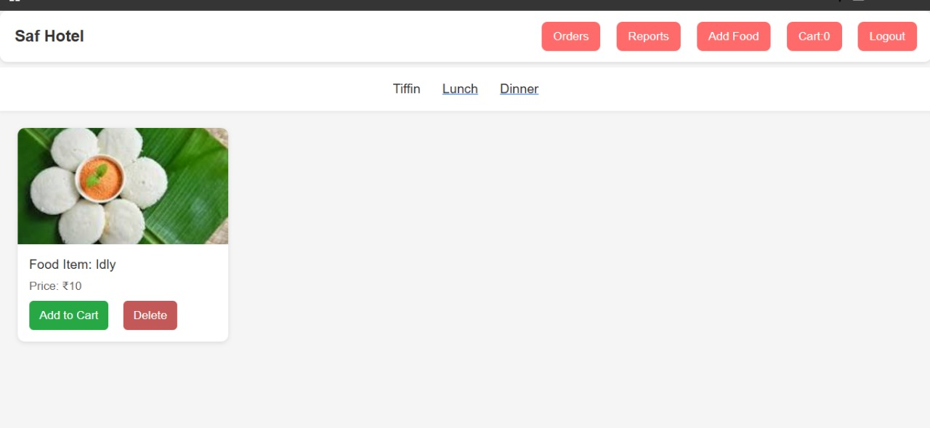
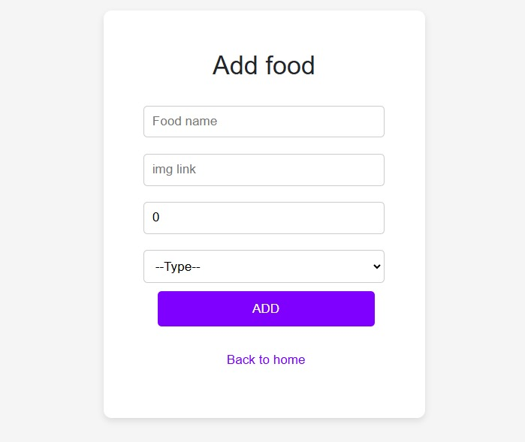
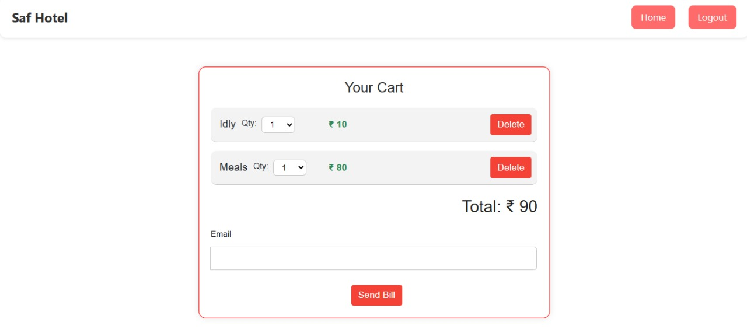
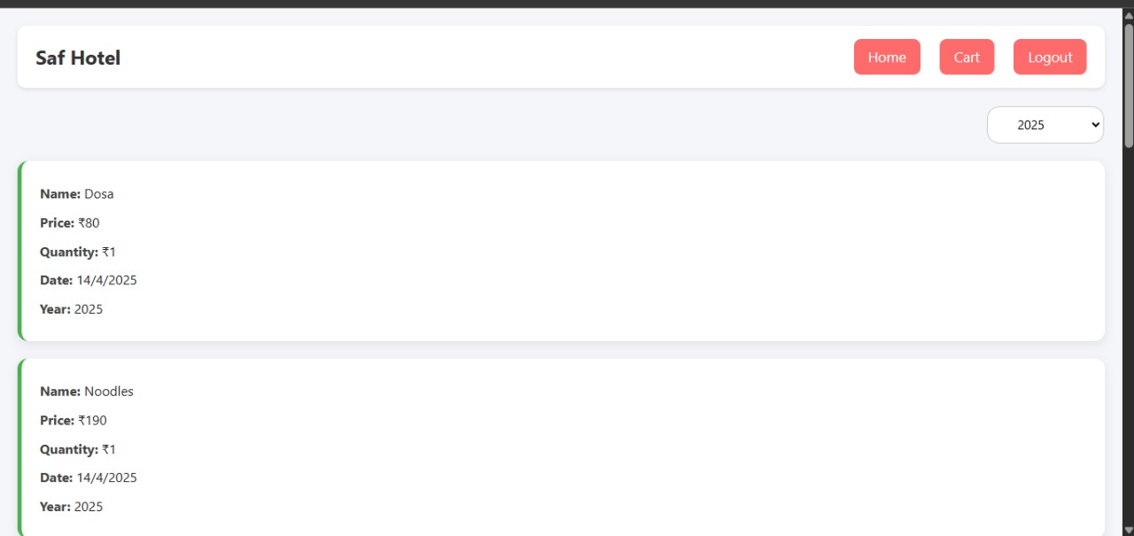
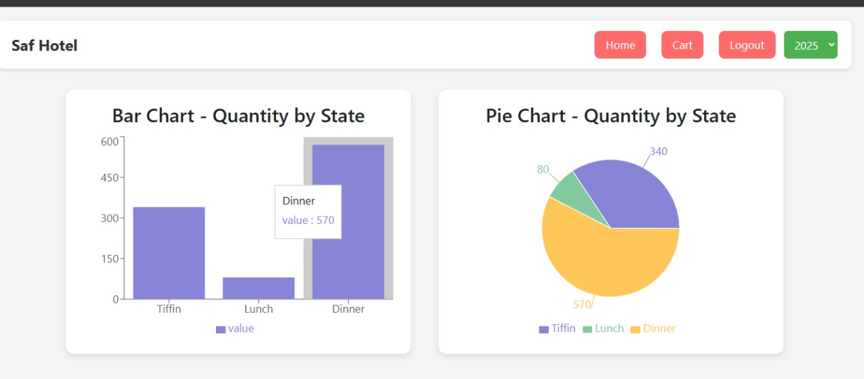
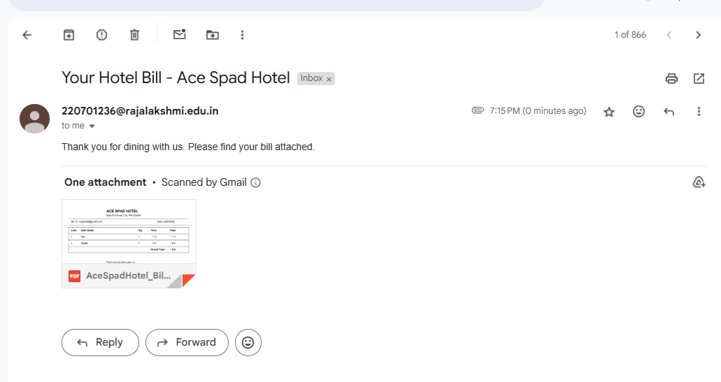
Results of Module

Slide 11
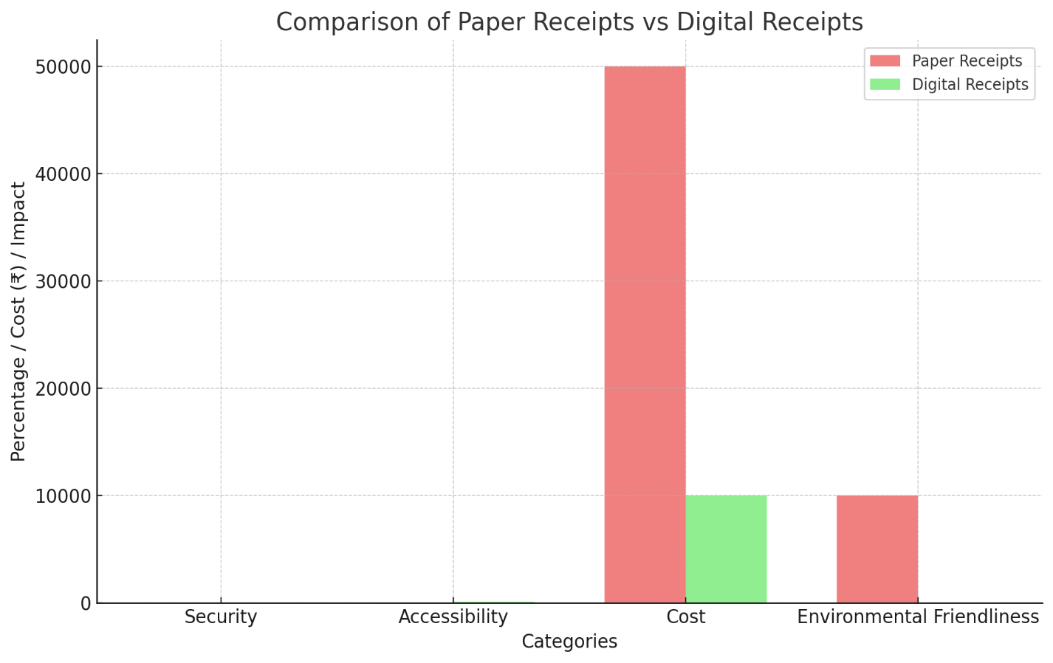
Conclusion & Future Work
Payment Gateway Integration: Automate receipt generation by integrating with PayPal, Stripe, or Razorpay.
Multi-Currency Support: Support multiple currencies with automatic conversion based on user location.
Enhanced Analytics: Provide advanced analytics with trends and machine learning for predictive insights.

Slide 12
References
[1] R. Vatsa et al., “Impact evaluation of a digital health platform empowering Kenyan women across the pregnancy-postpartum care continuum: A cluster randomized controlled trial,” PLoS Med, vol. 22, no. 2, p. e1004527, Feb. 2025.
[2] C. Gray, C. Santos, N. Bielova, and D. Clifford, “Dark Patterns and the Legal Requirements of Consent Banners: An Interaction Criticism Perspective,” Feb. 2021, Available: https://papers.ssrn.com/abstract=3780377. [Accessed: Apr. 22, 2025]
[3] C. Santos, N. Bielova, and C. Matte, “Are Cookie Banners Indeed Compliant With the Law? Deciphering EU Legal Requirements on Consent and Technical Means to Verify Compliance of Cookie Banners,” Aug. 2020, Available: https://papers.ssrn.com/abstract=4206054. [Accessed: Apr. 22, 2025]
[4] C. Matte, N. Bielova, and C. Santos, “Do Cookie Banners Respect my Choice? Measuring Legal Compliance of Banners from IAB Europe’s Transparency and Consent Framework,” Nov. 22, 2019. Available: http://arxiv.org/abs/1911.09964. [Accessed: Apr. 22, 2025]

Slide 13
Paper Publication Status
Yet to Publish

Slide 14
Thank You

